Slide 1
Welcome
To
Week Two
Notes:
All meetings will be recorded and copies will be available in the Knowledge Base
Please put questions in the chat log. This will be monitored through the meeting
Please Mute during presentations in order to avoid background noises etc
Knowledge Base – Login and Password – will be sent by email.
Have you returned your NDA yet? Also pics and bios
Please let us know if you need to miss a session.

Slide 2
Your 12 Week Journey
Week 1: Engaging, Agreeing the ROI and Setting Success Criteria from Day One
Week 2: Critical Universal KPIs and the Universal Business Growth Drivers
Week 3: Get an In-Depth Business Understanding in Less than 5 minutes
Week 4: The 'Conversation' Become Indispensable and Agree Commercials
Week 5: Creating a Credible Profit and Loss Forecast Part 1 of 2
Week 6: Creating a Credible Profit and Loss Forecast Part 2 of 2
Week 7: Real World Planning and How to Obtain Business Finance
Week 8: From 'Dust Trap' to Alchemist - Reporting Actual vs Plan +++
Week 9: If I Give You £10 and ask for £1 Back, How Many £10's Do You Want?
Week 10: Quick Wins Cost Savings Deliver an Instant ROI
Week 11: Business Intelligence Answering All The Other Questions
Week 12: Putting It All Together: From DIY to DFY and Become Indispensable

Slide 3
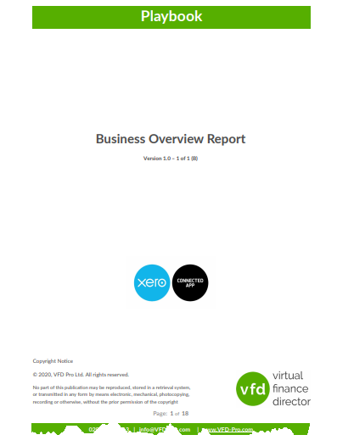
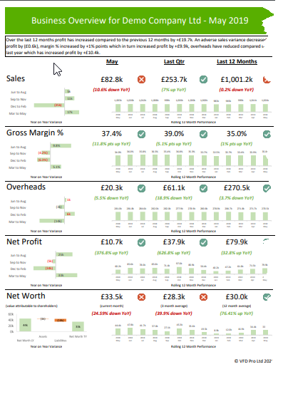
Have you:-
Downloaded the VFD-Pro Demo-Report?
Downloaded the VFD-Pro Business Overview Report - Playbook?
Read through them?

Slide 4
This Week’s “Homework”
Practice your discussion in time for Thursday
Work groups the same as last week.
Jeremy Webb & Dermot O’Kane Charlie McClelland & David Lee Cliff Spolander, David Mack and John Minchell John Greene & Jimmy Garnier

Slide 5
Until Thursday…
Helping SME’s develop, grow and thrive so they in turn will create more employment with all the benefits that will bring to UK industry.
Ray Watson
Director
Business Growth Advice Ltd
www.Business-Advisor.org.uk

